Slide 1
Basic Crystallography – Data collection and reduction

Slide 2
Basic Crystallography – Data collection and reduction
What Jim said…

Slide 3
X-rays
The diffractometer
Choosing/mounting a crystal
Data Collection Strategy

Slide 4
References and Additional Resources
Faculty of Science, Bijvoet Center for Biomolecular Research, Crystal and Structural Chemistry. ‘Interpretation of Crystal Structure Determinations’ 2005 Course Notes: http://www.cryst.chem.uu.nl/huub/notesweb.pdf
The University of Oklahoma: Chemical Crystallography Lab. Crystallography Notes and Manuals. http://xrayweb.chem.ou.edu/notes/index.html
Müller, P. Crystallographic Reviews, 2009, 15(1), 57-83.
Müller, Peter. 5.069 Crystal Structure Analysis, Spring 2010. (Massachusetts Institute of Technology: MIT OpenCourseWare), http://ocw.mit.edu/courses/chemistry/5-069-crystal-structure-analysis-spring-2010/. License: Creative Commons BY-NC-SA

Slide 5
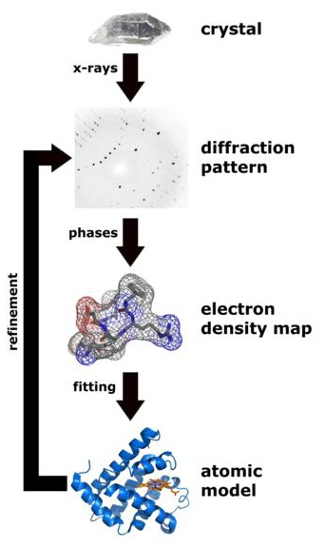
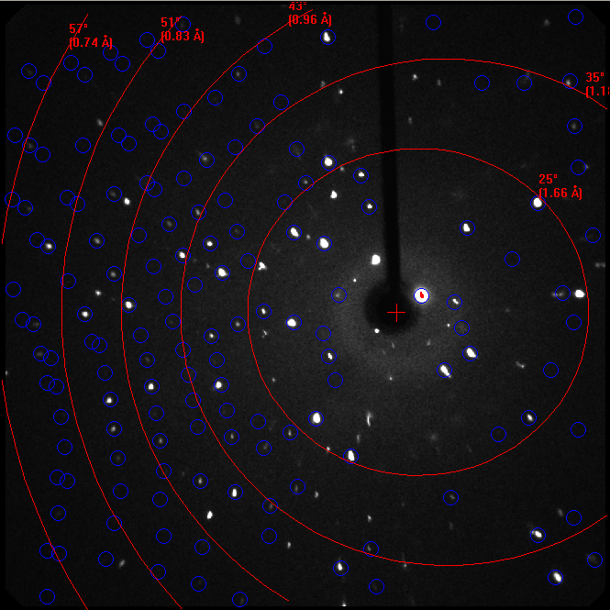
X-ray Crystallography
Notes:
5

Slide 6
Data Collection and Processing
Select and mount the crystal.
Center the crystal to the center of the goniometer circles (instrument maintenance.)
Collect several images; index the diffraction spots; refine the cell parameters; check for higher metric symmetry
Determine data collection strategy; collect data.
Integrate/reduce the data by applying background, profile (spot-shape), Lorentz, polarization and scaling corrections.
Determine precise cell parameters.
Collect appropriate information for an absorption correction. (Index the faces of the crystal. A highly redundant set of data is sufficient for an empirical absorption correction.)
Apply an absorption correction to the data.
(http://xrayweb.chem.ou.edu/notes/collect.html)

Slide 7
Data Collection and Processing
Select and mount the crystal.
Center the crystal to the center of the goniometer circles (instrument maintenance.)
Collect several images; index the diffraction spots; refine the cell parameters; check for higher metric symmetry
Determine data collection strategy; collect data.
Reduce the data by integrating, applying background, profile (spot-shape), Lorentz, polarization and scaling corrections.
Determine precise cell parameters.
Collect appropriate information for an absorption correction. (Index the faces of the crystal. A highly redundant set of data is sufficient for an empirical absorption correction.)
Apply an absorption correction to the data.
(http://xrayweb.chem.ou.edu/notes/collect.html)

Slide 8
Data Collection and Processing
Select and mount the crystal.
Center the crystal to the center of the goniometer circles (instrument maintenance.)
Collect several images; index the diffraction spots; refine the cell parameters; check for higher metric symmetry
Determine data collection strategy; collect data.
Reduce the data by integrating, applying background, profile (spot-shape), Lorentz, polarization and scaling corrections.
Determine precise cell parameters.
Collect appropriate information for an absorption correction. (Index the faces of the crystal. A highly redundant set of data is sufficient for an empirical absorption correction.)
Apply an absorption correction to the data.
(http://xrayweb.chem.ou.edu/notes/collect.html)

Slide 9
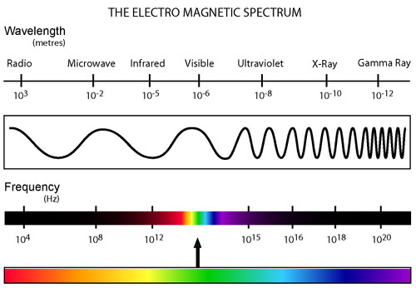
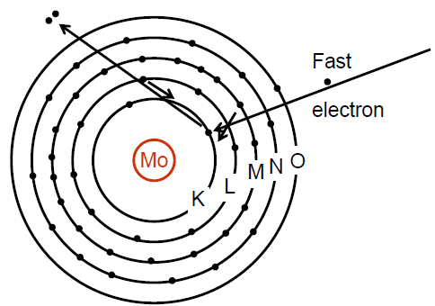
Single crystal diffraction of X-rays
Principle quantum number
n = 1 → K level
n = 2 → L level
n = 3 → M level
etc…
Note: The non SI unit Å is normally used.
1 Å = 10⁻¹⁰ m
L to K transitions produce 'Kα' emission
M to K transitions produce 'Kβ' emission.
M to L transitions produce 'Lα' emissions.
There are several energy sublevels in the L, M, N levels so there are in fact 'Kα1' and 'Kα2' peaks which are very close to one another in energy.
Notes:
9

Slide 10
Each element has its own characteristic x-ray spectrum
Single crystal diffraction of X-rays
For Copper the characteristic wavelengths (λ) are:
Cu Kα₁ = 1.540Å
Cu Kα₂ = 1.544Å
Cu Kβ = 1.392Å
For Molybdenum they are:
Mo Kα₁ = 0.70932Å
Mo Kα₂ = 0.71354Å
Mo Kβ = 0.63225Å
We use MoKα (avg.) radiation
(λ) = 0.71073Å
Or CuKα (avg.)
(λ) = 1.54178Å
A. Sarjeant
Notes:
Graphically, this is what the x-ray spectrum looks like for a given element. You can see the large hump of Bremsstrahlung radiation, and the spikes for given electronic transitions.
In crystallography, for laboratory sources, we deal mostly with Copper and Molybdenum radiation.
You can see that there are two distinct peaks, and one of them is split into a doublet. The doublet is the Kα transition and it is split because there are two closely spaced energy levels in the L shell.
Looking at the x-ray wavelengths produced for each transition, you can see why these would be useful to study molecular structures. (Hint: they’re on the order of interatomic distances!).

Slide 11
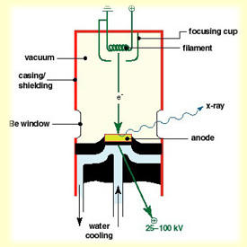
Single crystal diffraction of X-rays
A large potential difference (ex. 50kV) is put between a tungsten filament (cathode) and a metal target (anode; ex. Molybdenum).
Electrons ejected from the filament ionize electrons from the target material. When these electrons drop back into the vacated energy levels, they give off energy partially in the form of electromagnetic radiation (and a lot of heat; the tube is water cooled.)
Different metal targets emit X-rays of different wavelengths.
http://xray0.princeton.edu/~phil/Facility/Guides/Phillips_sealed_tube.jpg
Notes:
11

Slide 12
Single crystal diffraction of X-rays
A large potential difference (ex. 50kV) is put between a tungsten filament (cathode) and a metal target (anode; ex. Molybdenum).
Modern air-cooled microfocus sources generate significantly greater X-ray intensity.
Beryllium windows (toxic; do not touch!) are relatively transparent to X-rays and let the X-rays escape the evacuated tube.
http://xray0.princeton.edu/~phil/Facility/Guides/Phillips_sealed_tube.jpg
Notes:
12

Slide 13
Choosing a Crystal
Upcoming lecture on crystal growth
Worth spending time carefully looking for the best possible crystal using a polarized microscope
Your structure refinement will only be as good as the data that you collect
Limitations:
Crystals that desolvate readily and are not amenable to prolonged examination
The “best” crystal may not be representative of the bulk sample.
“Garbage In = Garbage out” (P. Müller, 2009)

Slide 14
Choosing a Crystal
Upcoming lecture on crystal growth
Worth spending time carefully looking for the best possible crystal using a polarized microscope
Your structure refinement will only be as good as the data that you collect
Limitations:
Crystals that desolvate readily and are not amenable to prolonged examination
The “best” crystal may not be representative of the bulk sample.
“Garbage In = Garbage out” (P. Müller, 2009)

Slide 15
Crystal Mounting
Normally crystals are selected to be smaller than the diameter of the beam to ensure a constant volume of irradiated matter
Crystals can be cut to size (with some practice)
Critically examine a few initial images
https://www.bruker.com/fileadmin/user_upload/8-PDF-Docs/X-rayDiffraction_ElementalAnalysis/SC-XRD/Webinars/Bruker_AXS_Growing_Mounting_Single_Crystals_Webinar_201011026.pdf

Slide 16
Crystal Mounting
Other considerations
Tools for mounting
The actual mount
Oil, epoxy, UV-curing
https://xray.chem.tamu.edu/documents/tools/tool.php
Data Collection Temperature
Low temperature (ex. 100 K) to minimize thermal vibrations
Constant temperature (even if collected close to RT, use of a low temperature device to maintain a constant temperature throughout experiment)

Slide 17
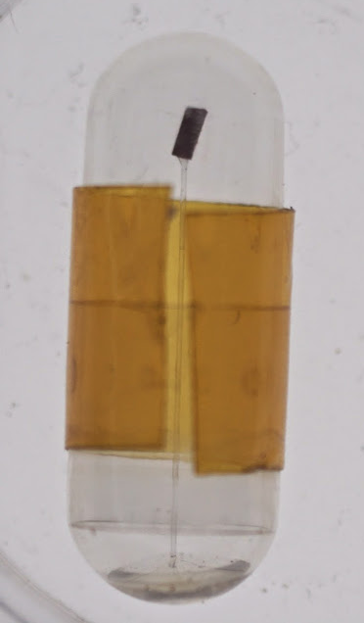
Crystal Mounting
https://www.bruker.com/fileadmin/user_upload/8-PDF-Docs/X-rayDiffraction_ElementalAnalysis/SC-XRD/Webinars/Bruker_AXS_Growing_Mounting_Single_Crystals_Webinar_201011026.pdf

Slide 18
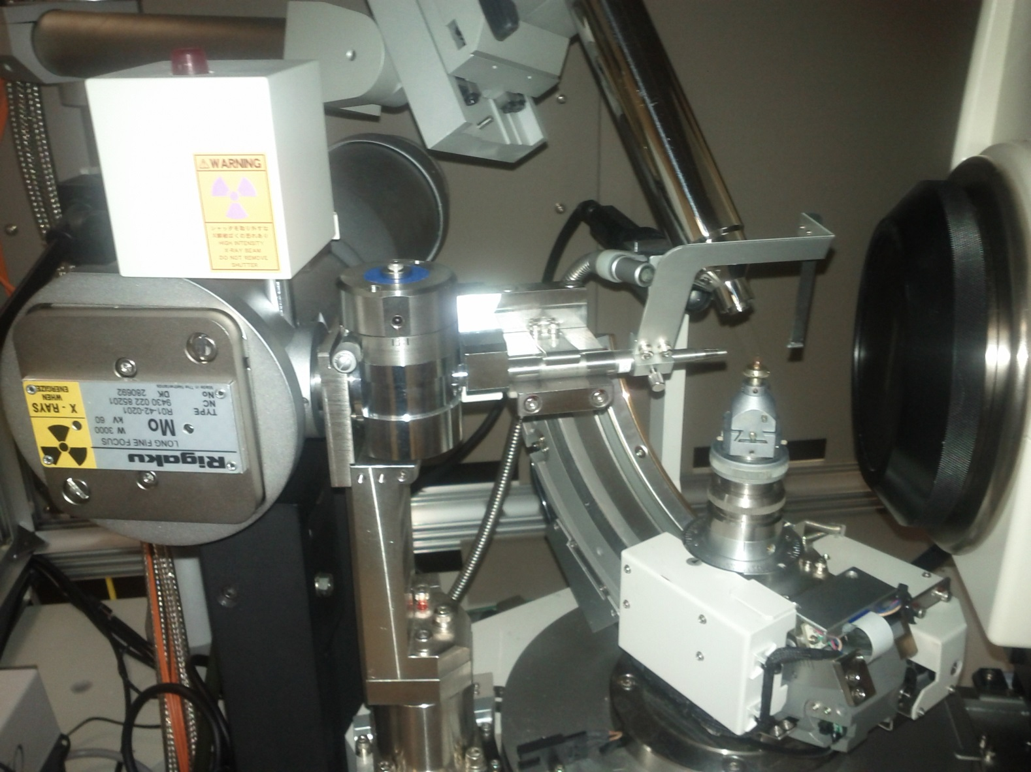
Single crystal diffraction of X-rays
Lights up when shutter is open
Sample
Beamstop (literally!)
Mo X-ray tube
CCD Detector
Graphite monochromator
Goiniometer
Collimator – Attenuates X-ray beam diameter
Notes:
18

Slide 19
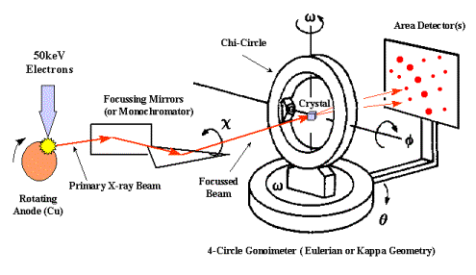
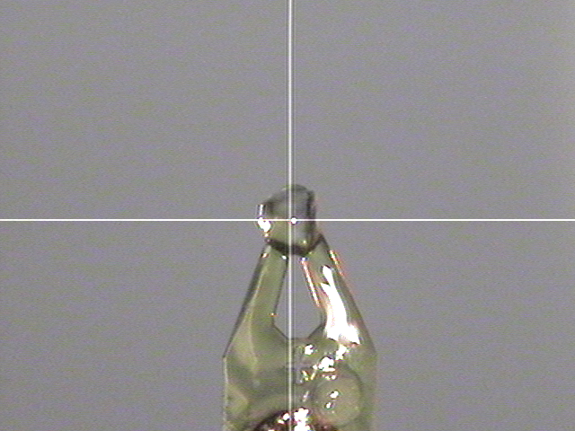
Single crystal diffraction of X-rays
Monochromator
Collimator
Mo or Cu Source
λ = 1.5418 Å
λ = 0.7107 Å
Notes:
19

Slide 20
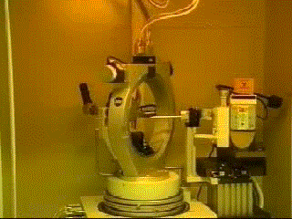
Eulerian Geometry
A. Sarjeant

Slide 21
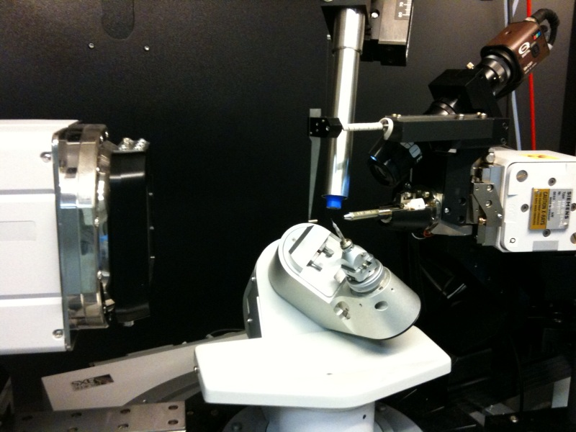
Kappa Geometry
κ
φ
dx
ω
2θ
A. Sarjeant
Notes:
At Northwestern, our three diffractometers have Kappa geometry, which is shown here.
It is called a Kappa geometry because instead of a Chi angle, we now have Kappa. The Kappa angle is offset by 50deg. from the omega axis. And because of this non-orthogonal axis, we are able to reach more areas of space, and put more reflections into diffracting position, than with the “Ferris wheel” chi angle. Kappa systems are a type of 4-circle instrument because they maintain four angular degrees of freedom. An older instrument that we retired last year was a type of 3-circle instrument because the chi angle was fixed and therefore we only had three angles to adjust.
Our Kappa goniometers also have movable detectors which help accommodate samples with widely disparate unit cell sizes as well as the swinging kappa arm.
The cold stream blows a stream of nitrogen gas over the sample keeping it cold, keeping it protected from water and oxygen in the atmosphere, and keeping it from decomposing or losing solvent. X-ray diffraction experiments will determine atomic positions. At lower temperatures, the thermal motions of the atoms are much smaller, making it much easier to get accurate atomic positions. Yet another reason to keep the sample cold while you are collecting data.
The direct beam passes through the collimator from the source tube to the crystal. The crystal is mounted on the end of a fiber on a goniometer head. The goniometer head can be translated in three dimensions to ensure the crystal is in the center of the x-ray beam and not precessing as it rotates. To make centering easier, a video camera is mounted on the diffractometer base, focused on the crystal.
The beamstop is situated behind the crystal, between the source and the detector to catch the primary beam. Most of the x-ray radiation will pass through or around the crystal (if it is smaller than the beam). If the direct beam is allowed to hit the detector, it will overload the electronics and wash out all the diffracted beams and you won’t see any spots. [Think about taking a picture of a back-lit subject. Typically the light overwhelms everything and you can’t see the details of your subject.]
This diffractometer also has a movable detector which helps accommodate different unit cell sizes as well as the swinging kappa arm.

Slide 22
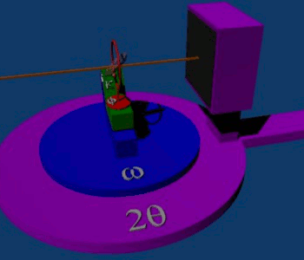
A. Sarjeant
Notes:
This is an animation of the movement of a Kappa goniometer. Thanks, Wikipedia!

Slide 23
Instrumental Optimization
Regular maintenance
Correctly aligned
How do you know?
Stable test crystal that is regularly collected, with comparison to previous results.
When in doubt about your own instrument, recollect the test crystal.

Slide 24
Unit Cell Indexing

Slide 25
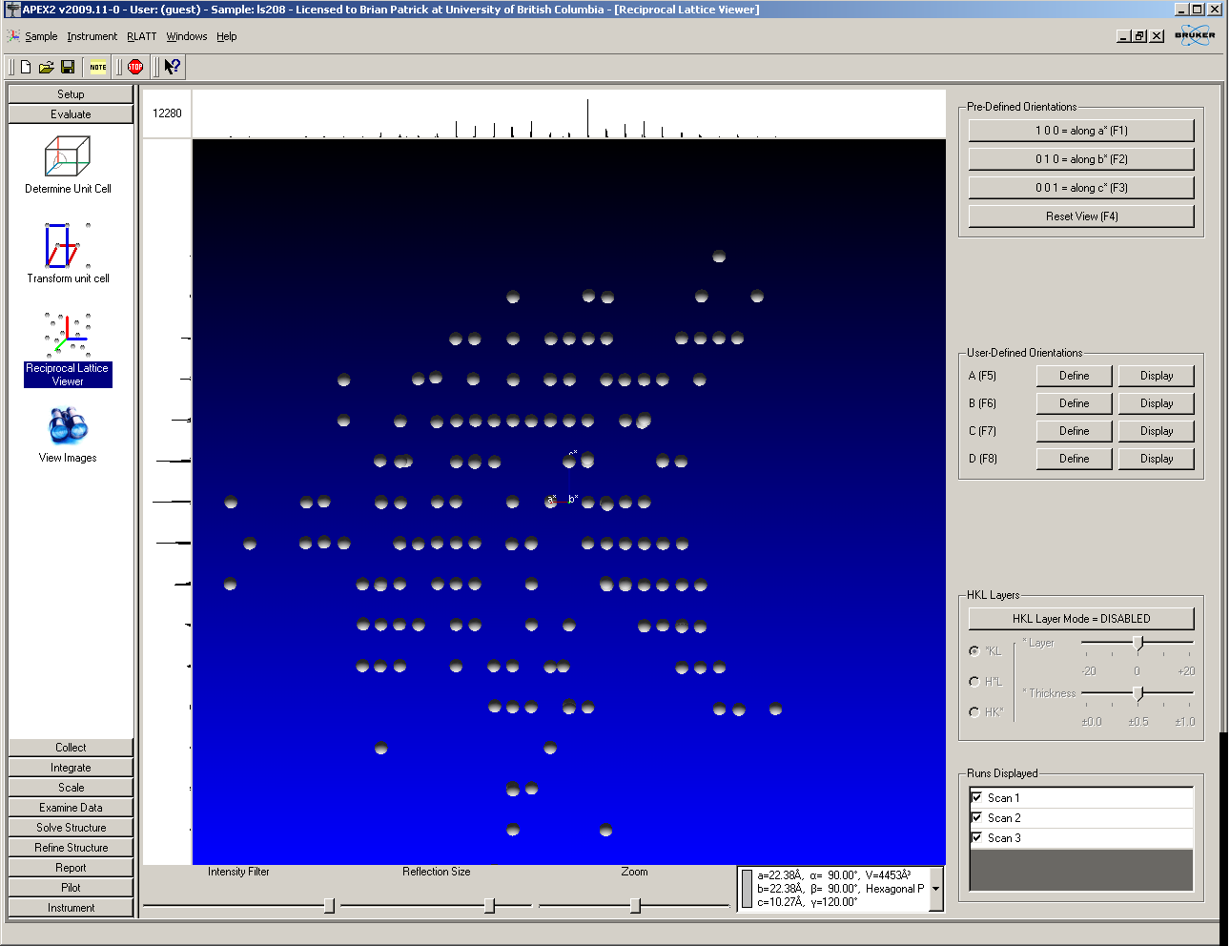
Unit Cell Indexing
Harvested 10 I/sig(I) reflections
a = 22.488 Å α = 90º
b = 22.488 Å β = 90º
c = 10.269 Å γ = 120º
Z’ =1

Slide 26
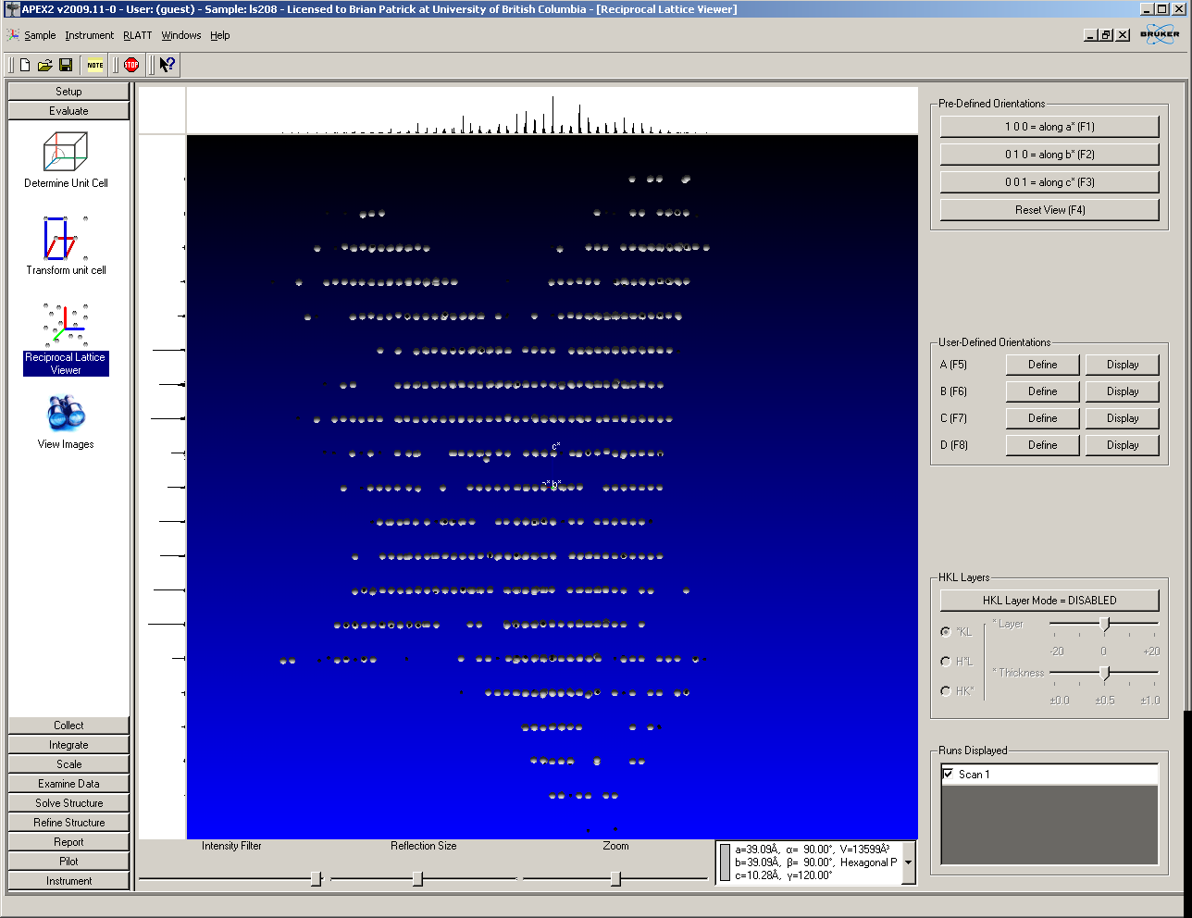
Unit Cell Indexing
Harvested 3 I/sig(I) reflections
a = 38.961 Å α = 90º
b = 38.961 Å β = 90º
c = 10.272 Å γ = 120º
Z’ = 3

Slide 27
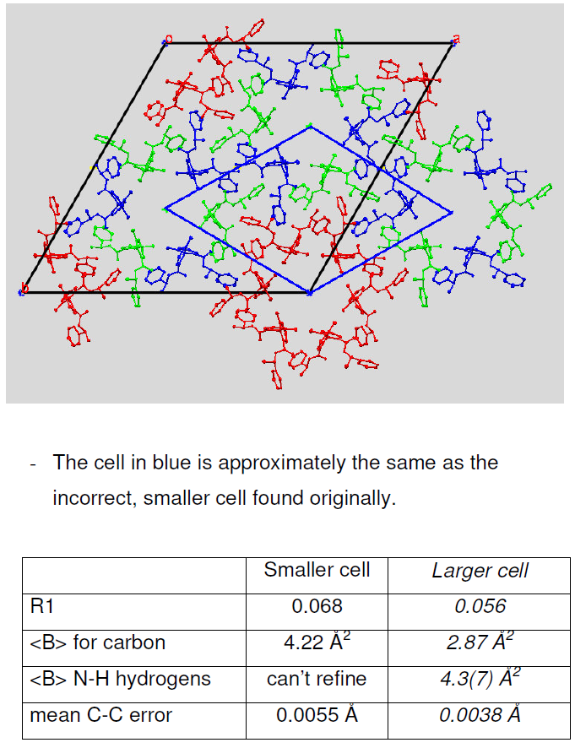

Slide 28
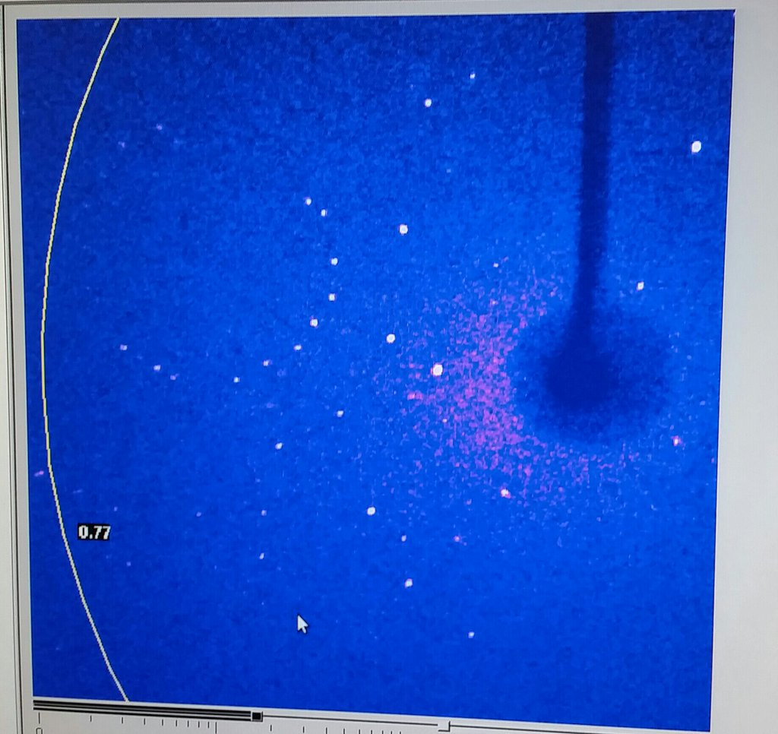
Data Collection Strategy: Maximum Resolution
Reflection intensities are generally weaker at higher resolutions, but high angle data contains important structural information.
IUCr generally
recommends a
minimum resolution of
0.84 Å.
(How does this
relate to Bragg’s Law?)

Slide 29

Electron density and resolution
1.20 A data (585 reflections)

Slide 30
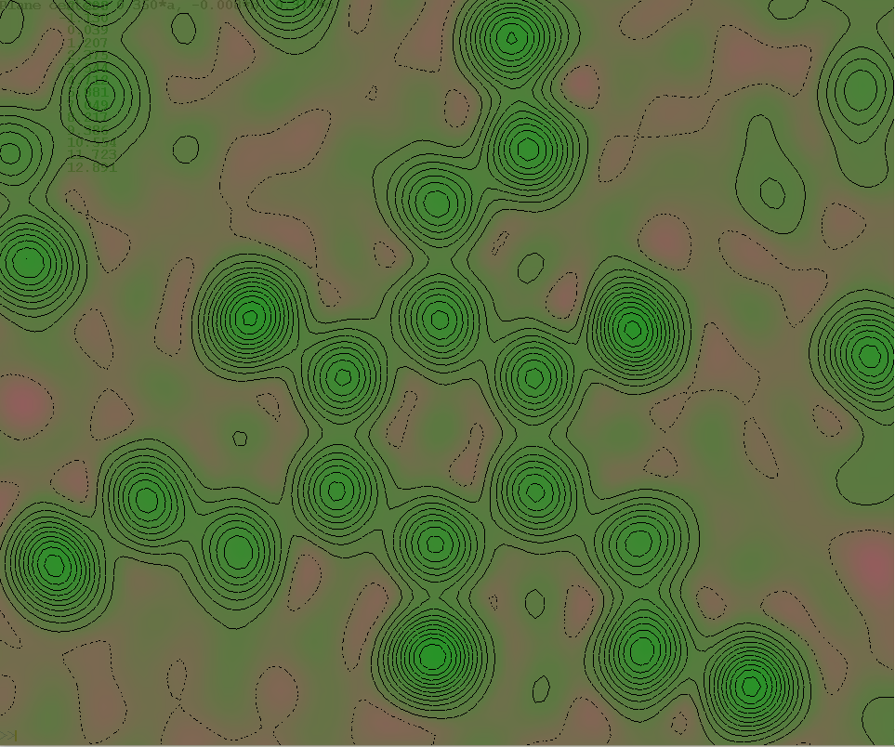
Electron density and resolution
1.00 A data (1016 reflections)

Slide 31
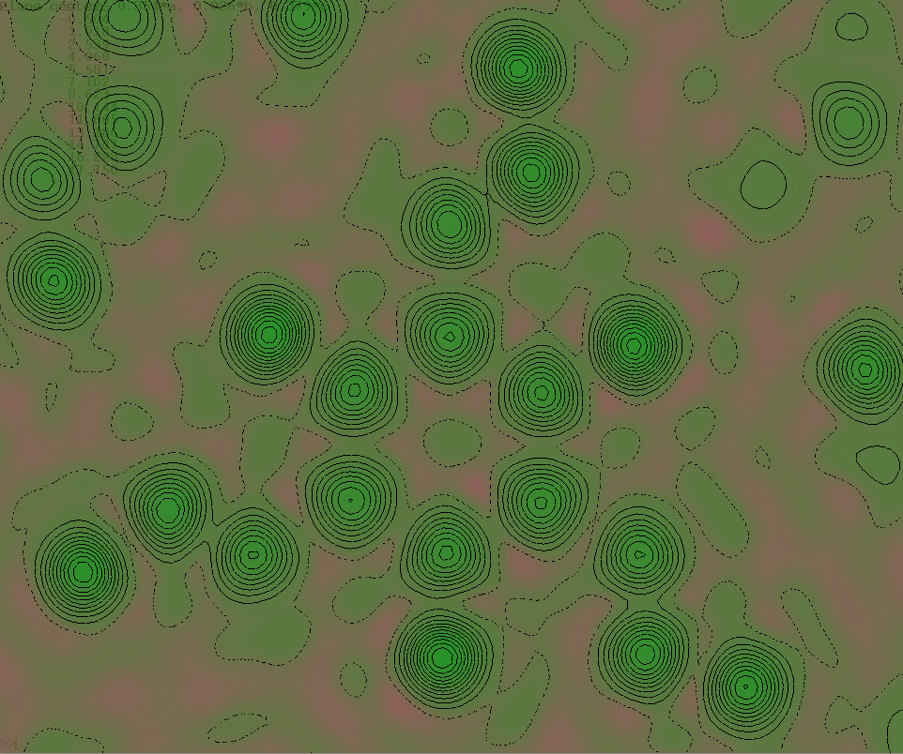
Electron density and resolution
0.83 A data (1761 reflections)

Slide 32
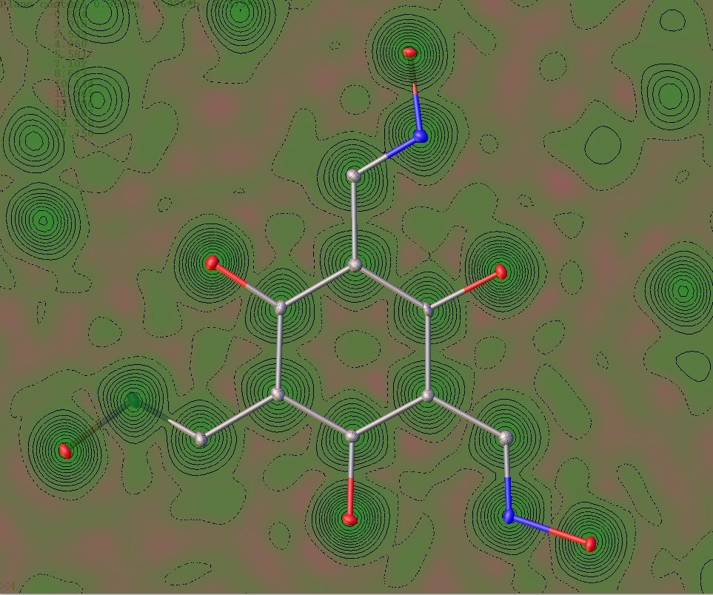
Electron density and resolution
0.83 A data (1761 reflections)

Slide 33
Data Collection Strategy: Maximum Resolution
Problem: The Acta Cryst standard for 2θ collections is a minimum cut-off of 53º for Mo-Kα radiation Why do you think that is?
Solution: Employing Bragg’s law with λ = 0.7107 Å (Mo-Kα radiation) and θ = 26.5º:
The normal range of X-H bonds is ~0.80-0.95 A. At 53º these separations can be resolved.
The normal range of X-H bonds is ~0.80-0.95 A. At 53º these separations can be resolved.

Slide 34
Data Collection Strategy: Data Completeness
Data completeness is the data actually collected compared to what is the unique data for the given crystal symmetry.
Software will allow you to determine a data collection strategy to yield 100% completeness.
Some crystallographers have developed their own collection strategies (based on presumed low symmetry and experience.)

Slide 35
Data Collection Strategy: Multiplicity of Observations
Multiplicity of Observation (MoO) refers to multiple measurements of the same, or symmetry equivalent, reflection, obtained from a different crystal orientation.
Higher values of MoO should yield better statistics
Higher symmetry crystals require less images to obtain equivalent MoO to lower symmetry crystals
One approach is to collect all crystals as though they were triclinic (over-estimating symmetry can yield incomplete data.)

Slide 36
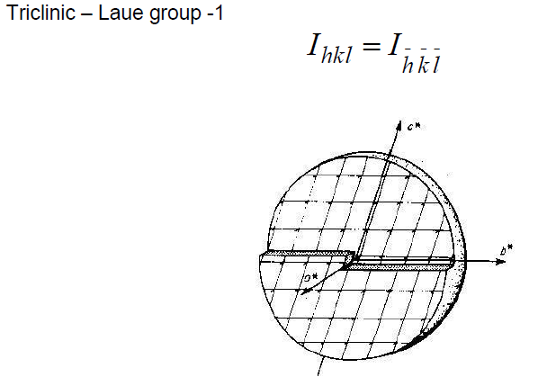
Crystal symmetry and Multiplicity

Slide 37
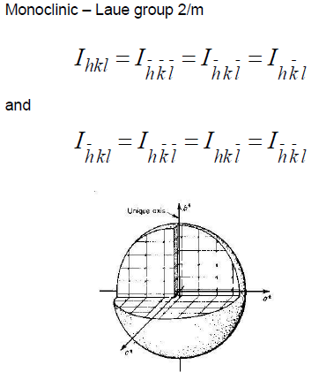

Slide 38
Two-fold symmetry about b-axis

Slide 39
Two-fold symmetry about b-axis
Mirror symmetry perp to b-axis

Slide 40
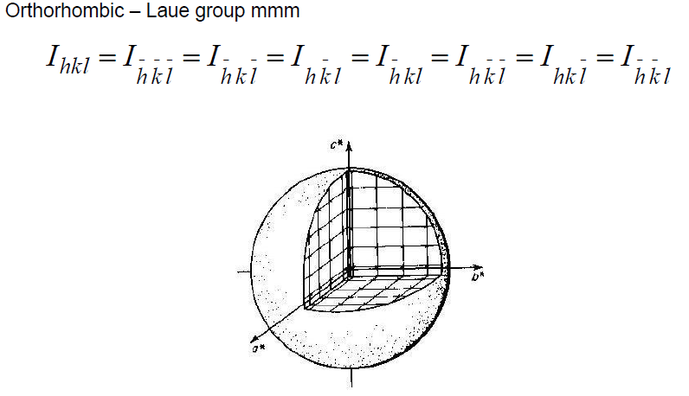

Slide 41
wR2 = 0.090
wR2 = 0.074
R1 = 0.041
R1 = 0.029

Slide 42
Avg C-C bond precision vs. multiplicity

Slide 43
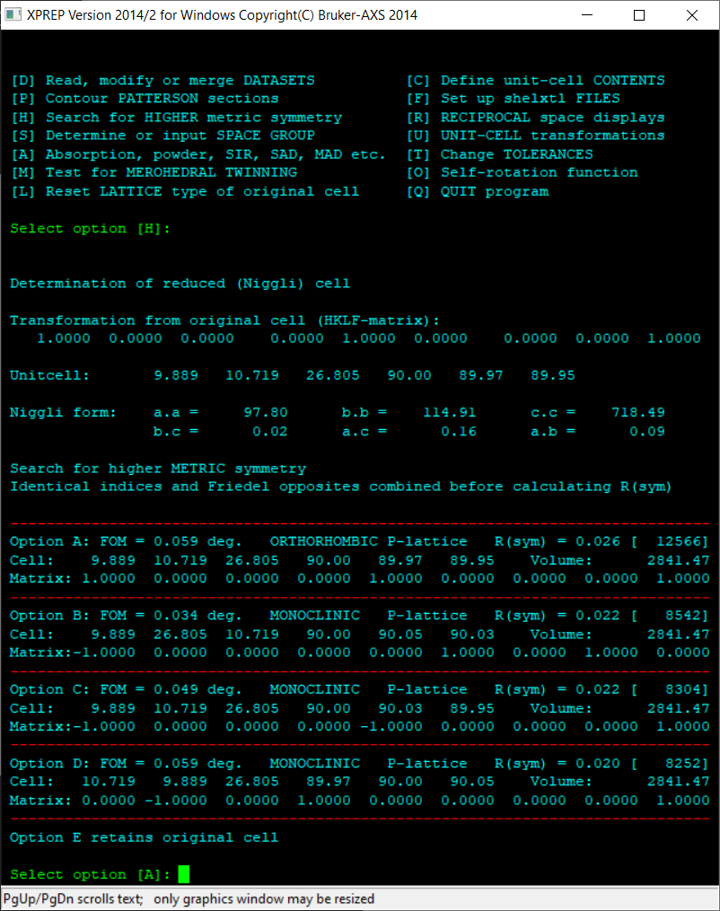

Slide 44
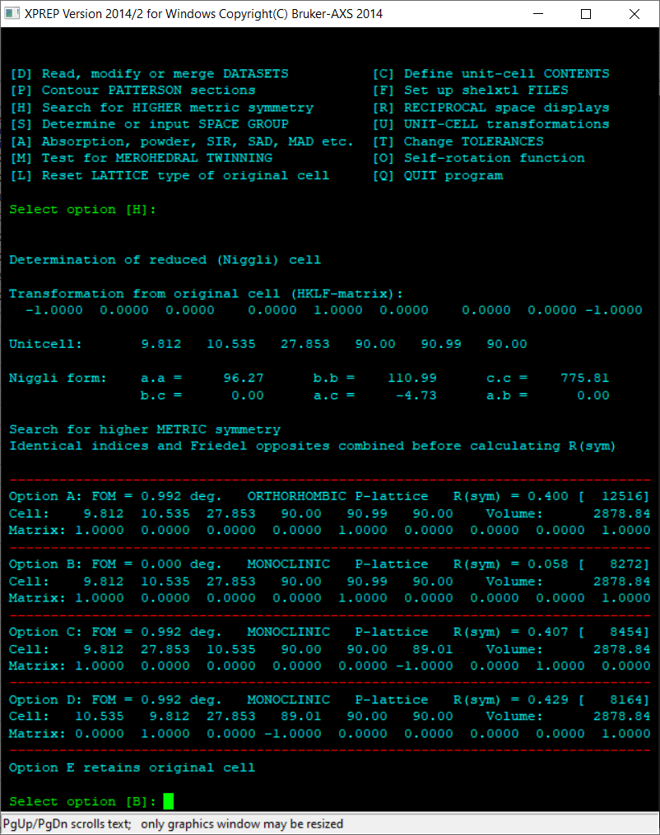

Slide 45
Data Collection Strategy: Crystal-to-detector
Dx 1
λ=0.71073 Å (Mo Kα)

Slide 46
Data Collection Strategy: Crystal-to-detector
Dx 2

Slide 47
Data Collection Strategy: Crystal-to-detector
Dx 1
λ=1.5418 Å (Cu Kα)

Slide 48
Data Collection Strategy: I/σ
Average measured intensity/estimated noise
Ideally should be as
high as possible (~10
throughout the data
set)
Values less than 2
are essentially noise
Decisions about where
to cut off your resolution?

Slide 49
Processing
Modifications to measured I(hkl) are required to correct for geometry of measurement
Essential to yield high quality accurate data for solution and refinement.
Some correction factors include:
Lorentz factor (accounts for time required for a Bragg reflection to cross the surface of the sphere of reflection)
Polarization factor (polarization of the incident X-ray beam)
Absorption (intensity of measure reflections is reduced by the absorption of X-rays by the crystal)

Slide 50
Processing: Corrections
For a small crystal completely bathed in a uniform beam of radiation, the integrated intensity, I, is given by:
I = Iº (r_{e})² (Lp/A) (λ/Ω) (F/V)² λ²υ
The quantity r_{e} = e²/mc² = 2.82 × 10⁻¹³ cm is the classical radius of an electron. V is the unit cell volume; υ is the volume of the crystal. Ω is the angular velocity of the sample as the peak moves through the Ewald sphere. Correction terms include the Lorentz correction, L, the polarization correction, p, and the absorption correction, A.
http://xrayweb.chem.ou.edu/notes/collect.html#correction

Slide 51
Processing: Absorption Corrections
The absorption of X rays follows Beer's Law:
I / Iº = exp(-μ × t)
where I = transmitted intensity, Iº = incident intensity, t = thickness of material, μ = linear absorption coefficient of the material. The linear absorption coefficient depends on the composition of the substance, its density, and the wavelength of the radiation. Since μ depends on the density of the absorbing material, it is usually tabulated as the related function mass absorption coefficient μ_{m} = (μ / ρ).
The linear absorption coefficient is then calculated from the formula:
μ = ρ ∑ (P_{n} / 100) × (μ / ρ) = ρ ∑ (P_{n} / 100) × μ_{m}
where the summation is carried out over the n atom types in the cell, and P_{n} is the percent by mass of the given atom type in the cell.
http://xrayweb.chem.ou.edu/notes/collect.html#corrections

Slide 52
Processing: Absorption Corrections
Crystals were ground or cut to be approximately spherical in order to minimize unequal absorption effects
Numerical absorption corrections require accurate information about crystal shape by way of indexing a crystal’s faces. Analytical absorption corrections are accomplished by mathematically dividing the sample into very small pieces and calculating the transmittance for each piece of the crystal for each reflection measured. This can be difficult for crystals with many closely spaced faces. The hkl indices of faces and their distances from the center of the crystal are required. Less common now, but still used for very strongly absorbing materials and charge density studies.
Modern semi-empirical methods are based on measurement of equivalent reflections and work well when there is a high multiplicity of observations. By comparing the intensities from the redundant measurements, an absorption surface for the sample is calculated.
http://xrayweb.chem.ou.edu/notes/collect.html#corrections

Slide 53
Processing: Absorption Corrections
Crystals were ground or cut to be approximately spherical in order to minimize unequal absorption effects
Numerical absorption corrections require accurate information about crystal shape by way of indexing a crystal’s faces. Analytical absorption corrections are accomplished by mathematically dividing the sample into very small pieces and calculating the transmittance for each piece of the crystal for each reflection measured. This can be difficult for crystals with many closely spaced faces. The hkl indices of faces and their distances from the center of the crystal are required. Less common now, but still used for very strongly absorbing materials and charge density studies.
Modern semi-empirical methods are based on measurement of equivalent reflections and work well when there is a high multiplicity of observations. By comparing the intensities from the redundant measurements, an absorption surface for the sample is calculated.
http://xrayweb.chem.ou.edu/notes/collect.html#corrections

Slide 54
Single crystal diffraction of X-rays: Safety
Normally, X-ray lab users must become "authorized users“; these users wear badges that monitor any exposure to radiation. This is federally regulated.
Some general safety notes:
1. Know the expected path of the main X-ray beam. Always keep all parts of your body outside of this path.
2. Whenever possible, keep the safety doors to the instrument closed. For most modern instruments safeties are in place that make it impossible for the X-ray shutter to be open at the same time as the instrument doors.
3. No unauthorized personnel may defeat or override any safety features
Notes:
54

Slide 55
Single crystal diffraction of X-rays: Safety
Some extra safety notes:
There is a serious hazard associated with possible electrical shock. The X-ray generator is a highly-regulated DC power supply that operates at an applied voltage of 50 kV, and 30-40 mA (this may vary with instrument and operator.)
The X-ray generator has several large capacitors. Even when the instrument is turned off, these capacitors store sufficient power to injure and possibly kill a person. All work on any X-ray generator should be done only by personnel trained in high-voltage electronics.
Never work above or below the generator cabinet.
Notes:
55

